Slide 1
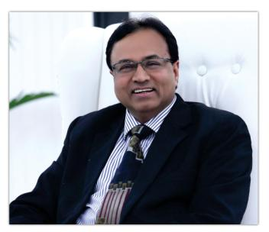
Mr. Pramod Goel
(Chairman & Managing Director)
The Beginning of a Dream…..
Victory Group was started in 1994 by Mr. Pramod Goel (FCA by profession) with a clear vision to focus on Premium Real Estate Developments in Residential & Commercial Projects.
Later on our Interests diversified in Office Spaces, Retail, Hospitality, Health, Education and Social Infrastructure.

Slide 2
Vision
Specialized leadership, Focus on Commitment and Consistent on time delivery define the trifecta of our vision. We aspire to give our clients a lifestyle at par with international standards keeping affordability and sustainable development in mind. To provide an integrated network of interlinked services with constant progress and commitment to deliver exceptional value for our investors, customers, personnel and community.
Mission
To emerge as the most admired innovative business leader and achieve excellence in real estate sector by maintaining the highest standards of technology, customer satisfaction and a spirit of partnership.

Slide 4
The 8 Pillars of Victory Infra….
Quality
Innovation
Knowledge
Customers
Partners
Respect
Transparency
Passion

Slide 5
Delivered Projects

Slide 6
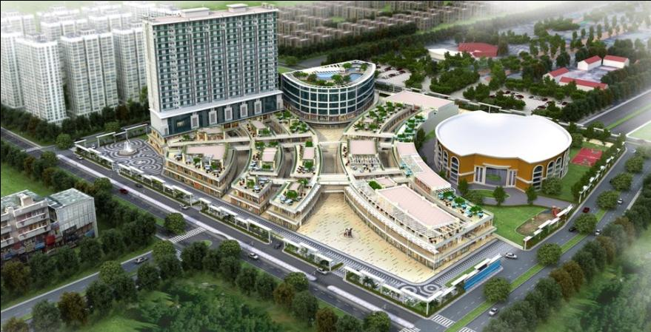
INDIRAPURAM HABITAT CENTRE
(Indirapuram, Ghaziabad)

Slide 7
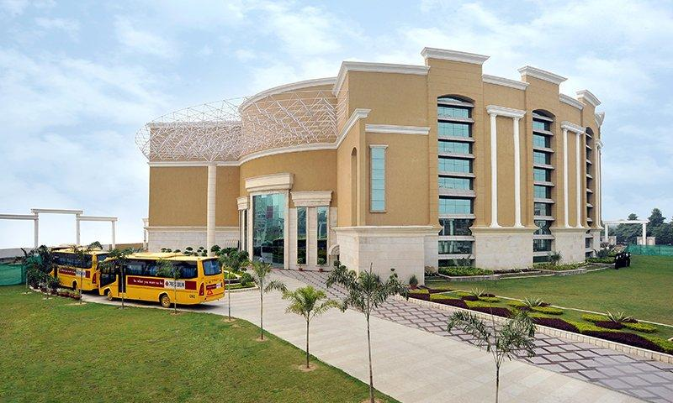
Education Project
PRESIDIUM SCHOOL
(Indirapuram, Ghaziabad)

Slide 8
Unique Selling Points
One of its kind state of the art combination of high street hypermarket, Luxury suites,restropubs,9 screen multiplexes and 1.10 lac sqft.entertainment & kids zone.
4 sided open 12.5 acre square plot with cultural & social community centre,School,digital library, ultra facility club & swimming pool.
Surrounded with plush residences. Strategically connected to metro and NH-24.

Slide 9
USP- continued
Exotic shopping destination includes beauty clinics and health clubs, mouth stumping cafes, Restaurants and plethora of multi-brand retails.
Indoor kids play area, 7000 basement car parking, party zones, huge banquet halls, fitness centre, grand spa and salons.
Proximity to Major MNC’s and commercial belt, Hospitals,schools,Malls,Metro,Railways& ISBT.

Slide 10
Project brief
12.5 Acre four sided open plot size.
Divided in 3 phases with 25 Lacs sqft area.
Presidium school in 2.5 Acre. Rest 10 Acre community and socio-cultural mix land use development.
Phase I is 80% leased out.
Phase II to be delivered in 6 months time
Phase III to be delivered in 18 months time.
Investment starts from 30 Lacs.

Slide 11
Project brief(cont.)
Phase II
Ground and 1st floor: Retail shops
II nd floor: Entertainment city having virtual and physical Gaming and kids zone, Bowling ally etc.
IIIrd floor: Service floor & common reception.
4th till 19th floor: fully furnished service appts.

Slide 12
Project brief( Cont.)
IIIrd phase
Ground and Ist floor: All Retail shops.
IInd floor: Club area and 9 screen Multiplex
The complete Project comprise of
Socio-cultural
Recreation
Commercial

Slide 13
COMPLETE LIST OF OPERATIONAL BRANDS
Westside
Studio Pepperfry
Geetanjali Salon
Anytime Fitness
Little After Dark
Toni & Guy Salon
The Monarch
Park Avenue
Keventers
Decathlon
Blackberrys
Baggit
Hira Sweets
Bata
Himalaya Optical
Pahnawa
Lil Lollipop
Manyavar
Reliance Trends
Berco’s
Bar-Be-Cue Village
Nut Lounge
Bean There
Dabur New U
Kaladikam
Miss & Master
Pahmos

Slide 14
COMPLETE LIST OF OPERATIONAL BRANDS
Colorplus
Chai Side
Baskin Robbins
KFC
Kebabwala
Levi’s
Kashana
Afsana
Aarson Optical
HealthKart
Chaayos
The Readers Café
John Players
Ajorca
Jamun Tree
Labhaa
Paprika
Vision Optics
Parineeta
Indifusion
Shree Rathnam
Shree Krishna Collection
Shree Krishna Watch Co.
Salon D’Paris
Not Just Furniture
Baker Street
Raymond
Style n Shine
Sai Creations
Homes Style

Slide 15
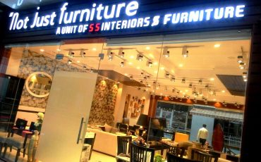
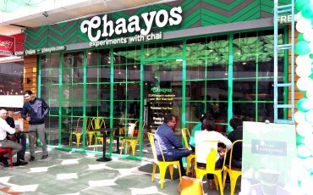
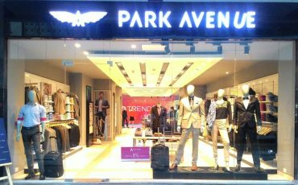
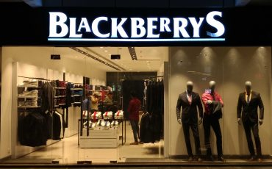
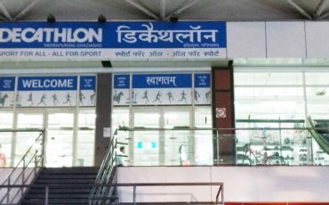
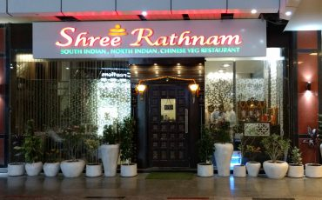
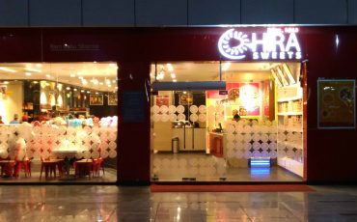
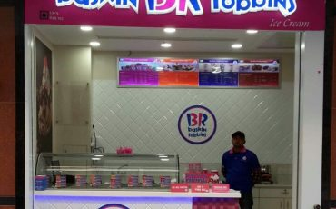
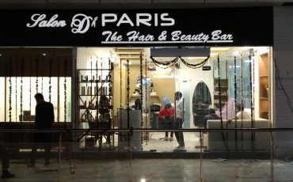
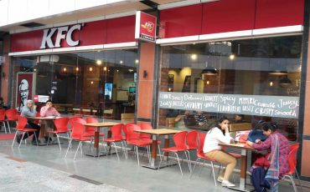
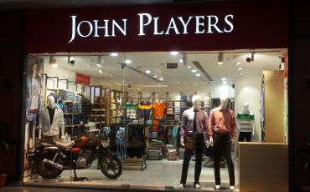
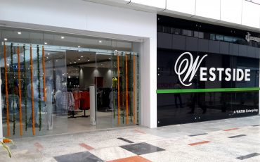
Picture Gallary

Slide 16
LIST OF BRANDS OPENING SHORTLY
PVR
Croma
Entertainment City
Zivame
Sports Station
Shoe Tree
Thompson Labs Co. Ltd.
Lifestyle
Yellow Chilli
Blizzard Ice Cream Parlour
Kolkata Biryani
The Fat Bird Bakery
Fattoush

Slide 17
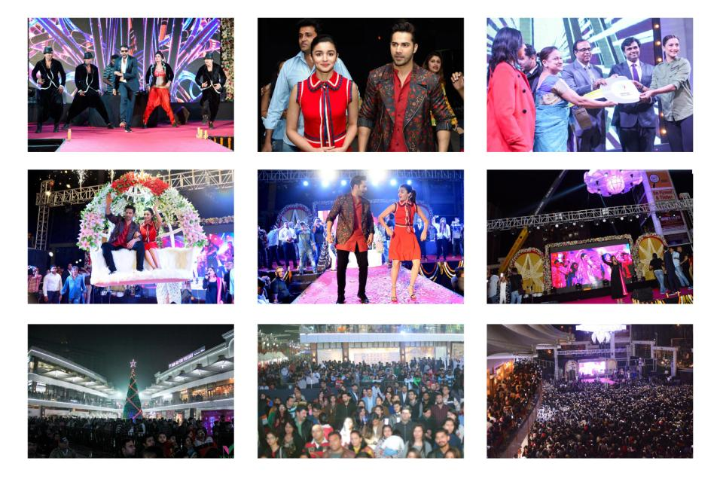
Events at Indirapuram Habitat Centre

Slide 18
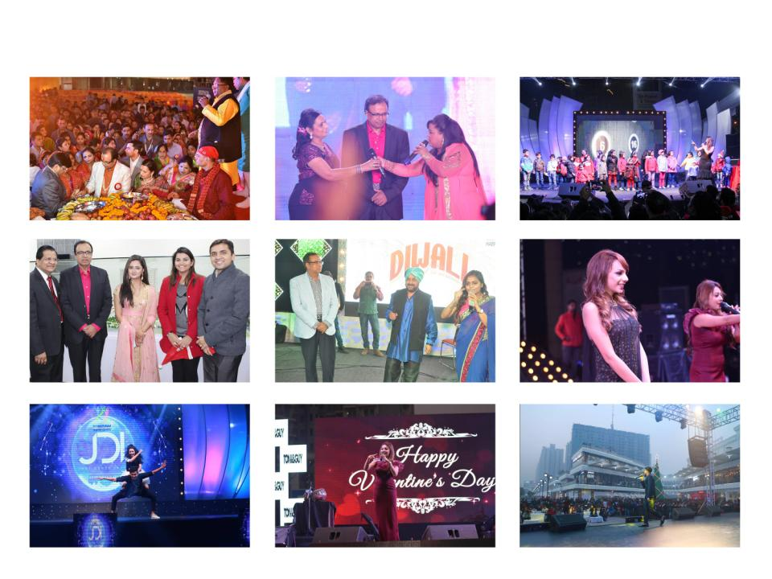
Events at Indirapuram Habitat Centre

Slide 19
NAVDEEP GOEL
# 9310073675
VR INFOBUILD LLP

